Slide 1
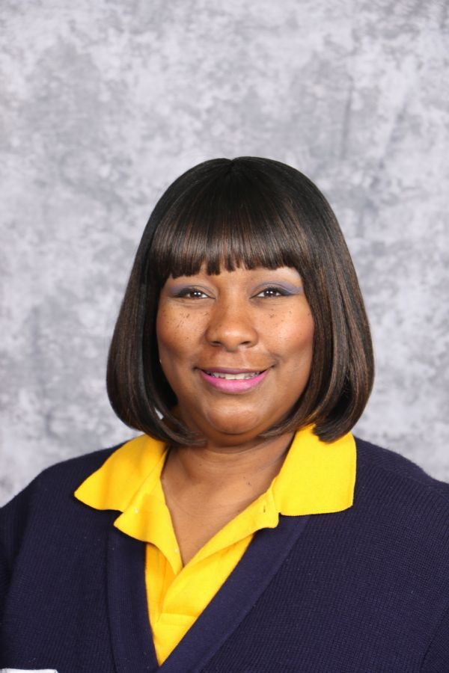
As your Parent-Liaison my main goal is to facilitate and provide information to parents and students about our current resources available throughout the school system and the community. In addition, I can provide you with information regarding; our school, our programs, and community services. Parenting Resources and Computers are also available; please stop by to check out our parenting books and resources on topics such as Discipline, Child Development, College Scholarship information, GED, Test taking skills and other fun activities to do with your child or get some needed training. and much more. Please note that all information discussed is confidential. You may reach me at lastanley-turner@apsk12.org or at 404-802 4950 Mondays -Friday between 9:00AM – 4:00PM and by appointment. If you have not already done so, please complete the Title I Parent Compact Form

